Slide 1

Singularity Overview
James Larus
Microsoft Research
(joint work with Galen Hunt and others)
Univ. Wisconsin, 11/8/05

Slide 2

Large Research Team
MSR Cambridge
  Paul Barham, Richard Black, Tim Harris, Rebecca Isaacs, Dushyanth Narayanan
MSR Redmond
  Advanced Compiler Technology Group:
    Juan Chen, Qunyan Mangus, Mark Plesko, Bjarne Steensgaard, David Tarditi
  Foundations of Software Engineering Group:
    Wolfgang Grieskamp
  Operating Systems Group:
    Mark Aiken, Chris Hawblitzel, Orion Hodson, Galen Hunt, Steven Levi
  Security and Distributed Systems:
    Dan Simon, Brian Zill
  Software Design and Implementation Group:
    John DeTreville, Ben Zorn
  Software Improvement Group:
    Manuel Fahndrich, James Larus, Sriram Rajamani, Jakob Rehof
MSR Silicon Valley
  Martin Abadi, Andrew Birrell, Ulfar Erlingsson, Roy Levin, Nick Murphy, Ted Wobber
2005 Interns
  Michael Carbin (Stanford)
  Adam Chlipala (Berkeley)
  Fernando Castor de Lima Filho
  (Universidade Estadual de Campinas)
  Martin Pohlack (TU Dresden)
  Avi Shinnar (Harvard)
  Mike Spear (Rochester)
  Aydan Yumerefendi (Duke)
2004 Interns
  Jeremy Condit (UC Berkeley)
  Daniel Frampton
  (Australian National University)
  Chip Killian (UC San Diego)
  Prince Mahajan (IIT Roorkee)
  Bill McCloskey (UC Berkeley)
  Martin Murray
  Tom Roeder (Cornell)
  Avi Shinnar (Columbia)
  Yaron Weinsberg
  (Hebrew University of Jerusalem)

Slide 3

“Modern”
OS & Applications
VMS
Windows
Multics
Unix
Linux
1970
1980
1990
Design parameters
  scarce resources
  benign environment
  knowledgeable and trained users

Slide 4

The World Changed
We were successful
  machines are fast, memory is cheap
  computers are ubiquitous
Malicious environment
  ubiquitous worms, viruses, scams, attacks, …
Few users understand computers or software

Slide 5
Singularity Project
Large project in Microsoft Research
  12+ people, 3 labs
New OS, languages, and tools
  attack problem from multiple directions
  working research prototype
Goal is more dependable systems
No magic bullet
  mutually reinforcing improvements to languages and compilers, systems, and tools

Slide 6
Singularity OS
channels
Dependable Kernel
  kernel closed at boot time
  OS services in processes
  device drivers in processes
    except interrupt controller, clock, timer, and boot console (in HAL)
  little unsafe code
    x86 assembly: 14 files (2%)
    C++: 21 files (3%)
    unsafe C#: 104 files (18%)
Dependable processes
  processes closed at start time
  only trusted runtime code can use unsafe C# features
  application code is 100% safe
  service code is 100% safe
  device driver code is 100% safe
Application
File System
Disk Driver
“CLR”
class
library
service
class library
driver
class library
runtime
runtime
runtime
kernel ABI
microkernel
page mgr
kernel
class library
IO mgr
scheduler
channel mgr
runtime
HAL

Slide 7
Key Directions
Safe programming languages
  optimizing compiler
  lightweight run-time environment
More run-time resilience
  failure boundaries
  explicit error notification
More mechanically verification
  specification at multiple levels
  closed environments with explicit interfaces
Application
File System
Disk Driver
“CLR”
class
library
service
class library
driver
class library
runtime
runtime
runtime
microkernel
page mgr
kernel
class library
IO mgr
scheduler
channel mgr
runtime

Slide 8
Challenge 1:
Pervasive Safe Languages
Microsoft C# is modern, safe language similar to Java
Singularity added features for systems programming
  increase programmer control over allocation, initialization, and memory layout
Highly optimizing compiler (MSR Bartok)
  extensive interprocedural optimization
  compiles MSIL to x86 binary
Lightweight run-time system
  minimal, customizable environment
Integrate language runtime into OS
  no distinct JVM or CLR
95% of Singularity kernel written in C#
  everything above written in safe C#

Slide 9
Closed Processes
Existing processes are open environment
  dynamic code loading and run-time code generation
Aggressive compiler optimization requires closed environment
  program analysis based on worst-case behavior assumptions
  (same for error detection)
  forced to be extremely conservative or dynamically recompile in open environment
Code loading reduces dependability
  85% of Windows crashes are device drivers
  no isolation boundary between code an extension

Slide 10
Singularity Processes
Singularity does not support dynamic code loading or run-time code generation
  all code present when process starts execution
  code may originate in many assemblies and libraries
Extensions execute in separate process
  two closed environments with well-defined interface
Library
Process
Extension
Process start
(or earlier)
Application

Slide 11
Customizable Environment
Existing run-time systems are large
  Java JVM and Microsoft CLR
  “kitchen sink” approach
  powerful, general-purpose solutions
  large memory footprints, slow execution
Replicate and extend OS functionality
  portability and fine-grain security

Slide 12
Singularity Environment
Singularity runtime, GC, and library selectable on per-process basis
  reduce runtime overhead
  enforce design discipline and system policies
Language support for factoring library code
Bartok tailors runtime and libraries to process’s code
  remove unused or disabled language features
  eliminate unused classes, methods, and fields
Libraries and kernel API strongly versioned
  transparent support for legacy code
  manifests make dependencies explicit

Slide 13
Process Size
 | Virtual address size (bytes) “Hello World”
 | Singularity | FreeBSD 5.3 | Linux 2.6.11 (Red Hat FC4) | Windows XP (SP2)
C - static lib |  | 232K | 664K | 544K
C++ - static lib |  | 704K | 1,216K | 572K
Sing# - GC | 408K |  |  | 3,750K
280K potentially sharable
Minimal process (no GC or exceptions) is ~16K

Slide 14
Challenge 2:
Run-Time Resilience
Verification will never catch or prevent all errors
Software errors should not cause system failure
Resilient system architecture
  isolate system components to prevent data corruption
  provide clear failure notification
  implement policy for restarting failed component

Slide 15
Software Isolated Processes (SIPs)
Lightweight managed code environment
  only executes safe code
  fast process creation and communications
  protection and failure isolation domain
Closed object space (not address space)
  enforced by language safety and interface design (not VM hardware)
  global invariants:
    no process contains a pointer to another object space
    no pointers from exchange heap into process
P1
P2
P3
exchange heap

Slide 16
Channels
Verifiable, efficient communications
  channel contract specifies value and communication protocol
  compiler verifies code obeys contract
  runtime validates communications
“Send & forget” message semantics
  each message and endpoint owned by at most one process
  ownership transferred at send
  zero copy

Slide 17
Channels
Verifiable, efficient communications
  channel contract specifies value and communication protocol
  compiler verifies code obeys contract
  runtime validates communications
“Send & forget” message semantics
  each message and endpoint owned by at most one process
  ownership transferred at send
  zero copy

Slide 18
Channels
Verifiable, efficient communications
  channel contract specifies value and communication protocol
  compiler verifies code obeys contract
  runtime validates communications
“Send & forget” message semantics
  each message and endpoint owned by at most one process
  ownership transferred at send
  zero copy

Slide 19
Process Independence
SIPs execute independently
  no shared implementation or state (outside kernel data structs)
  no shared memory
  process runtimes can differ completely (layout, GC, etc.)
OS enforces process isolation
  resources local to process
    can’t force memory allocation or GC in another process
    exchange heap data owned by single process
  kernel API maintains state isolation invariant
    does not allow process to affect another process
    e.g., no debugging functionality in base API
  interact only through visible, mediatable channels

Slide 20
Failure Isolation
SIP is failure boundary
  no shared data
  clean failure notification on channel
  resources reclaimed by OS
Recovery feasible, not automatic or transparent
  communication partners can recover and continue
Device drivers run in SIPs
  failure causes glitch, not bluescreen

Slide 21
Singularity Performance
 | Cost (CPU Cycles)
 | Singularity | FreeBSD 5.3 | Linux 2.6.11 (Red Hat FC4) | Windows XP (SP2)
Minimum kernel API call | 87 | 878 | 437 | 627
Message request/reply | 1,452 | 13,304 | 5,797 | 6,344
Process create & start | 300,000 | 1,032,000 | 719,000 | 5,376,000
Why?
  all SIPs run in ring 0
  static verification replaces hardware protection
  good optimizing compiler (not JIT)

Slide 22
Challenge 3: Verify More!
Integrate specifications throughout system
  language
  interprocess communication
  application descriptions
Detect errors early, trust code late
  language safety essential to system integrity
Singularity TCB
Sing#
C#
source
csc
Singularity
system
MSIL+
bartok
x86
sgc
compiler
verification
byte code
verification

Slide 23
Challenge 3: Verify More!
Integrate specifications throughout system
  language
  interprocess communication
  application descriptions
Detect errors early, trust code late
  language safety essential to system integrity
x86
Singularity TCB
Sing#
C#
source
csc
MSIL+
bartok
safety
proof
Singularity
system
sgc
compiler
verification
byte code
verification
application
verification

Slide 24
Channel Contract
public contract TcpConnectionContract {
...
state Connected : one {
Read? -> ReadResult;
Write? -> WriteResult;
GetLocalAddress? -> IPAddress! -> Connected;
GetLocalPort? -> Port! -> Connected;
DoneSending? -> ReceiveOnly;
DoneReceiving? -> SendOnly;
Close? -> Closed;
Abort? -> Closed;
}
state ReadResult : one
{
Data! -> Connected;
NoMoreData! -> SendOnly;
ConnectionClosed! -> Zombie;
}
...
}
Write
Connected
Write?
Read?
Data!
ReadResult
SendOnly
NoMoreData!
? = receive
! = send

Slide 25
Channel Contract
Contract
Client
public contract TcpConnectionContract {
...
state Connected : one {
Read? -> ReadResult;
Write? -> WriteResult;
GetLocalAddress? -> IPAddress! -> Connected;
GetLocalPort? -> Port! -> Connected;
DoneSending? -> ReceiveOnly;
DoneReceiving? -> SendOnly;
Close? -> Closed;
Abort? -> Closed;
}
state ReadResult : one
{
Data! -> Connected;
NoMoreData! -> SendOnly;
ConnectionClosed! -> Zombie;
}
...
}
...
conn.SendRead();
switch receive {
case conn.Data(readData) :
dataBuffer.AddToTail(readData);
return true;
break;
case conn.ConnectionClosed() :
return false;
break;
}
...

Slide 26
Channel Contract
Contract
Client
public contract TcpConnectionContract {
...
state Connected : one {
Read? -> ReadResult;
Write? -> WriteResult;
GetLocalAddress? -> IPAddress! -> Connected;
GetLocalPort? -> Port! -> Connected;
DoneSending? -> ReceiveOnly;
DoneReceiving? -> SendOnly;
Close? -> Closed;
Abort? -> Closed;
}
state ReadResult : one
{
Data! -> Connected;
NoMoreData! -> SendOnly;
ConnectionClosed! -> Zombie;
}
...
}
...
conn.SendRead();
switch receive {
case conn.Data(readData) :
dataBuffer.AddToTail(readData);
return true;
break;
case conn.ConnectionClosed() :
return false;
break;
}
...
Missing Case
case conn.NoMoreData() :
return false;
break;

Slide 27
Application Specifications
Application is first-class abstraction in Singularity
  code + resources + manifest
Manifest
  enumerate components, dependencies, and exports
  describe resource requirements
OS controls application installation
  verify code safety and conformance to manifest
  detect conflicts
  ensure conformance with system policies

Slide 28
Device Driver Specification
PCI Device
[DriverCategory]
[Signature("/pci/03/00/5333/8811")]
class S3Trio64Config : DriverCategoryDeclaration
{
[IoMemoryRange(0, Length = 0x400000)]
IoMemoryRange frameBuffer;
[IoFixedMemoryRange(Base = 0xb8000, Length = 0x8000)]
IoMemoryRange textBuffer;
...
[IoFixedPortRange(Base = 0x3c0, Length = 0x20)]
IoPortRange control;
[ExtensionEndpoint(typeof(ExtensionContract.Exp))]
TRef<ExtensionContract.Exp:Start> pnp;
[ServiceEndpoint(typeof(VideoDeviceContract.Exp))]
TRef<ServiceProviderContract.Exp:Start> video;
...
Dynamic resources from
PCI config (frame buffer)
Fixed resource
(VGA buffer)
Fixed resource
(VGA I/O Ports)
Requires channel to parent process for control
Exports channel for clients to access video device

Slide 29


Specification Used Many Ways
Driver
(Source+Spec)
Disk Driver
File
Sys.
driver
class library
Driver Manifest
Load driver
Allocate objects
Create channels
runtime
Conflict
microkernel
page mgr
kernel
class library
IO mgr
scheduler
System Manifest
channel mgr
runtime

Slide 30
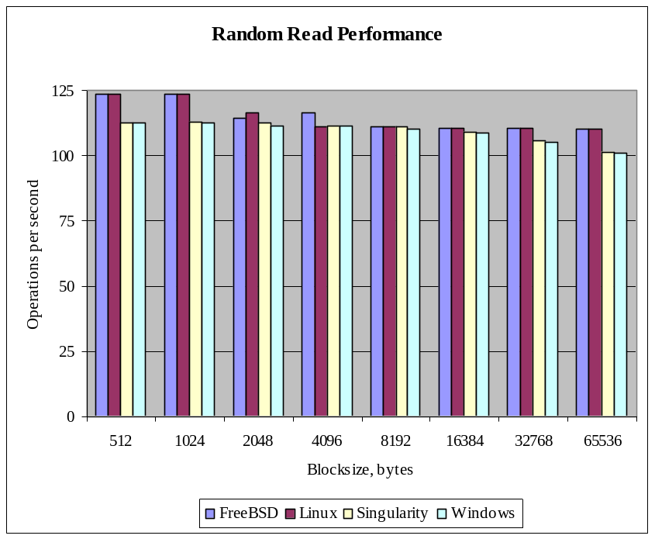
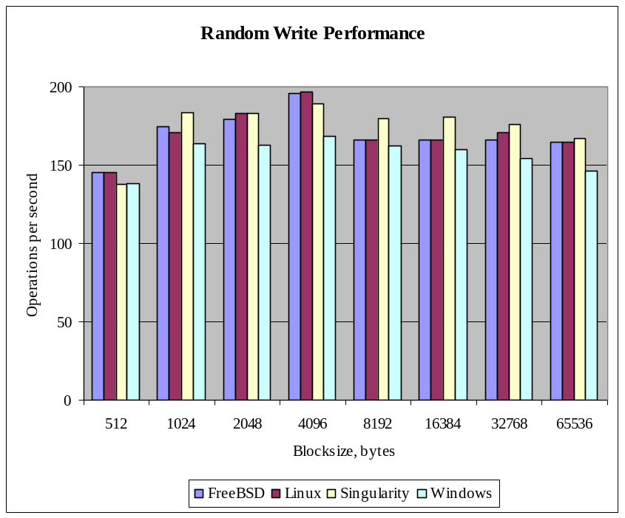
IO Performance

Slide 31
Macro Performance
SPECweb99 dynamic and static web content benchmark
  Singularity uses 6 processes:
    Cassini Web Server
    SPECweb content extension
    TCP/IP Stack
    NIC Driver
    File System
    Disk Driver
Singularity limited by FS implementation
  2.7 MBps on Windows, 2.6MBps on Singularity
 | Response Time ms/op | Throughput op/sec (Kbps/op)
Singularity | 322 | 91 (362)
Win Server 2003 (IIS) | 304 | 761 (336)

Slide 32
Singularity Security
Singularity controls crucial aspects of program execution
  installation
  verification
  run-time environment
  communications
Communication limited to explicit channels
  only access resources and outside world
  channels proxies can regulate content and/or resource consumption
Simpler security model
  security at process granularity (not CAS)
  applications are principals
Small TCB

Slide 33
Singularity and Concurrency
Singularity supports two-levels of parallelism
  very lightweight threads in SIP (shared memory)
  very fast communication between SIPs (message passing)
Best of both worlds?
  fine-grain concurrency within SIP
  independent or loosely coupled parallelism across SIPs
Language support for concurrency
  transactional memory
  specification and verification tools

Slide 34
Singularity Status (10/05)
Bartok compiler and runtime
  5 GCs
  BCL and parts of .NET libraries
  lightweight runtime environment
Singularity kernel
  processes, channels, and lightweight threads fully supported
  device drivers and services run in SIPs with channels
  device drivers configured through manifest
Sing# language
  contracts on all channels
  non-null checking applied to all Sing# code (~120 KLOC)
  MSIL verifier checking ownership and contract correctness
OS functionality
  Microsoft Cassini ASP.NET web server
  nameserver and volume manager
  Boxwood B-tree file system

Slide 35
Research Agenda
Reduce TCB
  verified typed assembly language (TAL) implementation
  extended TAL to capture more properties
  factor runtime and BCL libraries
  verify type safety of runtime and GC
Programming
  improved language support for channel communication
  transactional memory for concurrency control
Verification
  use Spec# and Boogie to specify and verify code
  tools for shared memory concurrency
Scheduling
  resource quotas and metering
  integrate GC with scheduling
Operational management
  declarative configuration and policy drives system

Slide 36
Summary
Singularity provides basis for more dependable systems
  pervasive use of safe programming languages
  lightweight, customizable run-time environment
  verifiable specification of system behavior
Working research prototype
  vehicle for driving research in large number of areas
More information: http://research.microsoft.com/os/singularity
MSR Tech Report MSR-TR-2005-135

Slide 37
Backup Slides

Slide 38
Controlling Access to Hardware
Hardware resources accessed through classes in trusted runtime
  IoPort, IoIrq, IoMemory, and IoDma
  IoPortRange, IoIrqRange, IoMemoryRange, and IoDmaRange
I/O objects allocated by kernel and passed to driver
Operations on I/O objects verify access before accessing hardware
For example:
    IoPortRange myDeviceRange = IoConfig.GetConfig().DynamicRange[0];
    IoPort maskPort = myDeviceRange.PortAtOffset(4, 1, Access.Write);
    maskPort.Write8(0xff);
Open research: describe and verify register usage at hardware/software interface

Slide 39
Application Manifest
PCI device
<driver identity="S3Trio64" signature="/pci/03/00/5333/8811">
<assemblies>
<assembly filename="S3Trio64.exe" ... />
<assembly filename="Namespace.Contracts.dll" ... />
<assembly filename="Io.Contracts.dll" ... />
<assembly filename="Corlib.dll" ... />
<assembly filename="Singularity.V1.ill" ... />
</assemblies>
<endpoints count=“2">
<extension startStateId="3“endpointEnd="Exp" contractName="Microsoft.Singularity.Extending.ExtensionContract" assembly="Namespace.Contracts" index="0" /> ...
</endpoints>
<fixedResources count="5">
<ioMemoryRange base="0xb8000" length="0x8000" index="0" /> ...
<ioPortRange base="0x3c0" length="0x20" index="2" />
</fixedResources>
<dynamicResources count="1">
<ioMemoryRange default="0xf8000000" length="0x400000" index="0" />
</dynamicResources>
...
List of MSIL assemblies
Channels
Fixed resources
Dynamic resources

Slide 40
Metadata-Driven Activation
Execution in kernel
// I/O manager creates and fills activation record
IoConfig config = new IoConfig();
config.dynamicRanges[0] = new IoMemoryRange(0xd0000000, 0x800000); // PCI
config.fixedRanges[0] = new IoMemoryRange(0xb8000, 0x8000);
config.fixedRanges[2] = new IoPortRange(0x3c0, 0x20);
process.IoConfig = config;
...
process.AddEndpoint(NameSpace.Bind(“/dev/video”));
...
Trusted execution in driver process
// activation object filled from activation record
frameBuffer = (IoMemoryRange)IoConfig.GetConfig().DynamicRanges[0];
textBuffer = (IoMemoryRange)config.GetConfig().FixedRanges[0];
control = (IoPortRange)config.GetConfig().FixedRanges[2];
...
video = new TRef<ServiceProviderContract.Exp:Start>(Ext.GetEndpoint(1));
...
ServiceProviderContract.Exp video = S3Trio64Resources.video.Acquire();
video.RecvConnect(out client);
...
Application code in driver

Slide 41
Versioning Kernel Dependencies
Without “formal” API description
  app compat bugs abound
  app dependencies aren’t verifiable
Application Binary Interface (ABI) is:
  minimal interface (~150 functions)
  defined by compiled ILL* assembly
  inscribed into app at compile time
ABI is a functional (not-OO) API
  only value types cross ABI
  separates app and kernel GC domains
  wrapped in BCL for ease of use
ABI maintains process independence
  cross-process operations exclusively through channels
ABI is layer of indirection for replacing implementation
Developer PC
Target Device
Program
(EXE)
Program
(EXE)
Class Libraries
(DLLs)
Class Libraries
(DLLs)
Process
Reference
ABI V1 Stub
(DLL)
ABI V1 (ILL)
ABI V1 Shim
Kernel V2
Kernel
*Interface Load Library (ILL): a MSIL Assembly containing publics w/o code

Slide 42
Compiling Runtime System and Libraries
Modular runtime system
MSIL
obj file
Libraries:
.NET
Singularity app
Singularity kernel
X86 executable file
MSIL
obj file
User programs
MSIL
obj file
They’re compiled, optimized, and linked, just like everything else

Slide 43
Bartok Support for CLR
Supported:
Core types + object model instructions
  integers, floats, objects, managed pointers, unmanaged pointers
Garbage collection, including finalizers, weak references
Exception handling
Lazy type initialization
Delegates
Unsafe code (kernel, runtime use only)
Data layout attributes
Generics (coming soon)
Not Supported:
Dynamic class loading
Reflection: very limited support
Code access security
Platform invoke

Slide 44
Lightweight Runtime System
Mark sweep
Mark sweep compact
Concurrent
Semi-space copying
Gen. copying
Reference counting
Automatic storage management
Virtual table and object layout
Threading and synchronization
Type tests
Core datatypes: integers, floating point, arrays, strings
Exception handling
Interface calls

Slide 45
Bartok Optimizations
Tree-shaking (whole program mode)
  Eliminate unreachable or unused classes, interfaces, methods, and fields
Array-bounds check elimination
Array store check elimination
Null check elimination
Devirtualization of virtual calls
Type-test and type cast elimination
Optimize class initialization
  Eliminate redundant checks
  Fast/slow path split
Redundant field load/store elimination
Optimize convert operations
  Widening/narrowing introduced by use of argument stack
Eliminate unused formal parameters
Compress paths of struct operations

